Slide 1

BDDM: Demystifying Computing with Python
The class will start soon…

Slide 2
BDDM-1-a+b
BDDM: Demystifying Computing
with
Python
Authors = [‘AP’, ‘SS’, ‘DA’]

Slide 3

What we will learn today?
Lecture outcomes:
What is a while loop?
Introduction to functions with Python
Lab outcomes:
Using the while loop
Working with data sources
“.txt” files
Coding functions

Slide 4
Recap
Input from the user:
name = input(“What is your name? ”)
Output to the user:
print(“Your name is ”, name)

Slide 5
Recap
Data type conversion:
int(<value>) #float, str…
Conditionals: Syntax
if <condition>:
<statement>
elif <condition>:
<statement>
else:
<statement>
Equal
10 == 10 -> This expression is True!
if (a==10) … If the condition is True…
a=10 is a value assignment not a condition
Not equal
5!=5 -> This expression is False!
if (a!=0): print(10/a)

Slide 6
Recap Data structures: Lists
thislist = [”Hemingway", ”Dickens", ”King"]
print(thislist)
thislist[0] = ”Orwell“ # Update a # value
print(thislist)
[”Hemingway", ”Dickens", ”King"]
[”Orwell", ”Dickens", ”King"]

Slide 7
Recap: iterating in a list (linear search)
writers = [”Hemingway", ”Dickens", ”King“, ”Christie”] # Search for writer King!
for writer in writers: if writer == ”King": print(writer)
break
King

Slide 8
Counters!
When we have a lot of data, we might need to count it!
Python provides the length function: len(mylist)
alist = [1, 4, 7, 98, 12]
print(len(alist))
Will print: 5
# I can also count the items using a
# for loop!
count = 0
alist = [1, 4, 7, 98, 12]
for element in alist:
count = count + 1
print(count)
# will print 5!

Slide 9
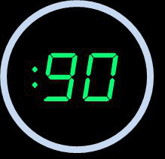
Time for a quiz
What is the error here?
count = 1
alist = [1, 4, 7, 98, ‘stelios’, 12]
for element in alist:
count = count + 1
print(count)
# will print 5!

Slide 10
Time for a quiz
Solution
count = 0
alist = [1, 4, 7, 98, ‘stelios’, 12]
for element in alist:
count = count + 1
print(count)
# will print 6!

Slide 11
Counters!
START
COUNT IS 0
FOR LOOP STARTS!
element is a, count increase to 0+1
COUNT IS 1
element is b, count increased to 1+1
COUNT IS 2
element is c, count increase to 2+1
COUNT IS 3
FOR LOOP ENDS
COUNT IS 3
We can increase/decrease a variable value in a loop!
Example:
alist = [“a”, “b”, “c”]
count = 0
for element in alist:
count = count +1
print(count)

Slide 12
The While command
While ‘for’ loop is used for iterating over a sequence
With the while loop we can execute a set of statements only as long as a given conditi
writers = [”Hemingway", ”Dickens", ”King"] for x in writers : print(x)

Slide 13
While loop
With the while loop we can execute a set of statements as long as a condition is true.
i = 1 while i < 6: print(i) i += 1

Slide 14
While loop
With the break statement we can stop the loop even if the while condition is true:
i = 1 while i < 6: print(i)
if i == 3: break i += 1

Slide 15
While loop
We can have a while loop using an indefinite True condition
while True: # or while(True) num = int(input(‘enter an integer: ’))
if num == 3: break
# True, not true...

Slide 16
While loop example
n = 5
No
n > 0 ?
Yes
What is this algo. doing?
n = 5
while n > 0 :
print(n)
n = n-1 #(n-=1)
print('Blastoff!')
5
4
3
2
1
Blastoff
print n
n = n -1
print 'Blastoff'

Slide 17
Breaking from while
The break statement ends the current loop and jumps out of to the while immediately
We use break to stop, when a condition is met
while(True):
num = int(input("Enter a number, or 0 to exit"))
print(num)
if num == 0:
print("...break!")
break

Slide 18
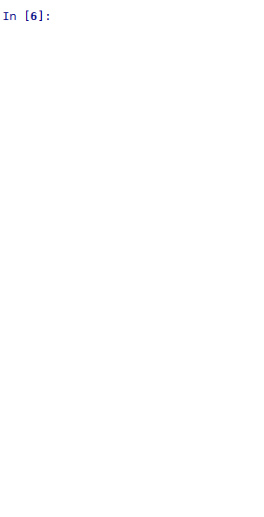
Breaking from while
The break statement ends the current loop and jumps to the statement immediately following the loop
while(True):
num = int(input("Enter a number, or 0 to exit"))
print(num)
if num == 0:
print("...break!")
break

Slide 19
Quiz
What does it print?
i = 1
while i<6:
i=i+1
if i == 4:
break
print(i)

Slide 20
Quiz
What does it print?
i = 1
while i<6:
i=i+1
if i == 4:
break
print(i)
2
3

Slide 21
Quiz
What does it print?
i = 1
while i<6:
print(i)
if i == 4:
break
i=i+1

Slide 22
Quiz
What does it print?
i = 1
while i<6:
print(i)
if i == 4:
break
i=i+1 # We always increase at the end
1
2
3
4
i=i+1
# OR
i+=1

Slide 23
Quiz: What’s wrong with this loop?
n = 1
No
n > 0 ?
Yes
n = 1
while n > 0 :
print(“Hi”)
print(“End”)
print “Hi”
print “End!”

Slide 24
Quiz: What’s wrong with this loop?
n = 1
No
n > 0 ?
Yes
n = 1
while n > 0 :
print(“Hi”)
print(“End”)
print “Hi”
print “End!”
This loop will never finish!

Slide 25
Indefinite loops
“While” loops are called "indefinite loops" because they keep going until a logical condition becomes False
The loops we have seen so far are pretty easy to examine to see whether they will terminate or become "infinite"
Sometimes it is a little harder to make sure that a loop will terminate
We need to create conditions to check all possible scenarios
We need to do it ourselves, and ahead of actually running the code. Why?

Slide 26
3 minutes with hardcore Computer Science
Alan Turing’s “Halt” theorem: deciding whether a code containing loops will ever end is not possible in general
Rice’s theorem: all non-trivial properties of a code can be mapped to Turing’s “Halt” problem (see above)
Consequence: checking that a code terminates in reasonable time, as well as other properties cannot really be automated
No automated Software Engineering is possible: you have to do it yourself.
Click here for a simple proof (YT video)
Click here to see what a “Turing machine” is

Slide 27
Indefinite loops
Quite often we have a list of items, effectively a finite set of things
We can use a for loop to iterate over a list of data.
Those are called definite loops because will execute an exact number of times
We say that:
definite loops iterate through the members of a set

Slide 28
For vs. While loop
The for statement is used to iterate over the elements of a sequence.
The while loop tells the computer to do something as long as the condition is met. Its construct consists of a block of code and a condition.

Slide 29
Recap on lists
# len(<list>)
alist=[1,3,7,9]
print(len(alist))
# This will print 4!
max(<list>)
min(<list>)
sum(<list>)

Slide 30
While in lists
alist = [1, 3, 7, 9]
count = 0 # Represents the index
while(True):
print(alist[count])
if count == len(alist)-1:
print("end")
break
count = count + 1
alist = [1, 3, 7, 9]
for anum in alist:
print(anum)
For loops:
Iterate for each element in a list
While there are elements:
Iterate
1
3
7
9
1
3
7
9

Slide 31
Quiz!
A while loop in Python is used for what type of iteration?
Definite
Indeterminate
Indefinite
Discriminant

Slide 32
Quiz!
A while loop in Python is used for what type of iteration?
Definite
Indeterminate
Indefinite
Discriminant

Slide 33
What can we do with a loop?
Search for a particular key value (e.g. person with passport number: AK3535123
Find the maximum/minimum of our data
Oldest person
Lowest debt
Math operations:
Average, sum etc.
Count values:
How many like star wars?
Filtering data:
Export students completed studies with distinction
Search in text:
How many times William Shakespeare refers to Verona In “The Tragedy of Romeo and Juliet (1594)”?

Slide 34
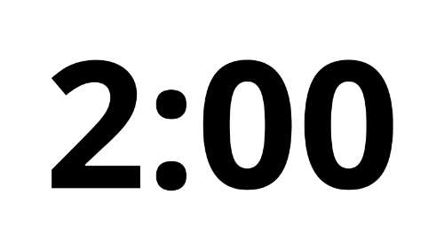
Quiz!
Complete question 3
Write a Python script (on VS Code or pen & paper):
Calculate the sum of a list of numbers e.g. [1,4,5]
Assume that your list has only numbers
Adapt your code to calculate the average of the list

Slide 35
Quiz!
alist = [1, 4, 5]
mysum = 0 # mysum will store the sum in each iteration
count = 0 # count will keep counting how many elements are in the list
for item in alist:
mysum = mysum + item
count = count + 1
print("Sum is ",mysum)
print("Average is ", mysum/count)

Slide 36
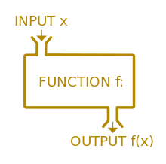
Functions
A function is a block of code.
It only runs when it is called!
You can pass data, known as parameters, into a function.
A function can return data as a result.
# Syntax
def <name>(<input_parameters>):
…
return <some_data>

Slide 37
More on functions
kinds of functions:
Built-in functions that are provided as part of Python - input(), print(), float(), int() …
Extra functions provided by modules to be included when coding (more later)
Functions that we define ourselves and then use
names of the built-in functions are reserved: avoid them as variable names
We call/invoke a function by using its name, parenthesis and list of arguments

Slide 38
Built-in functions
Argument/parameter
max_of_my_list = max( [1, 5, 7, 2, 6] )
print(max_of_my_list) # Will print 7!
Assignment
function

Slide 39
Functions
atext
len()
atext = “Hi there!”
9
len()
“Hi there!”
9
atext
def myCount(argument):
Count = 0
for letter in argument:
count=count+1
return(count)
atext = “Hi there!”
9

Slide 40
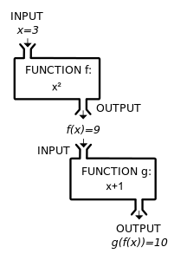
Functions
You can pass data known as parameters, into a function.
A function can return data as a result.
The return value of a function could be the input to another function.
def average_of_three(x,y,z):
return (x+y+z)/3
print(average_of_three(10,20,30))
def calc_square(x):
return x**2
print(calc_square(2))

Slide 41
Parameters
# This function does not RETURN a value, it only prints!
def greet(lang):
if lang == "es":
print("Hola")
elif lang == " fr " :
print("Bonjour")
else:
print("Hello")
greet("es")
A parameter is a variable which we use in the function definition
The variable allows the code in the function to access the arguments for a particular function invocation.

Slide 42
The “Return value” of a function
A “good” function is one that produces a result (or return value)
The return statement ends the function execution and “sends back” the result of the function
We still can include print statements in the functions
This is mainly for testing reasons

Slide 43
Multiple parameters and Arguments
We can define more than one parameters in the function definition
def addtwo(a, b):
added = a + b
return added
We simply use the arguments when we call the function
x = addtwo(3, 5)
We match the number and order of arguments and parameters:
3 goes to a and 5 goes to b

Slide 44
Void functions
When a function does not return a value, we call it a "void" function
Void functions usually print results
def sayhello(who):
print ('Hello,', who + '!’)
print ('What a lovely day.’)

Slide 45
When to use functions?
avoid repeating code!
Define a function and call it, by passing the correct number of arguments.
If a block becomes too long or complex!
Break it up in “logical” chunks
Put those chunks into functions
Make a library of common stuff that you do over and over - perhaps share it with your friends...

Slide 46
Quiz 1/4!
What is the default return value for a function that does not return any value explicitly?
None
Int
Null
String

Slide 47
Quiz 2/4!
Which of the following items are present in the function header?
function name
function name and parameter list
parameter list
return value

Slide 48
Quiz 3/4!
Which of the following keywords marks the beginning of the function block?
fun
define
def
function

Slide 49
Quiz 4/4!
Which of the following function definition does not return any value?
a function that prints integers from 1 to 100.
a function that returns a random integer from 1 to 100.
a function that checks whether the current second is an integer from 1 to 100.
a function that converts an uppercase letter to lowercase.

Slide 50
Quiz answers!
What is the default return value for a function that does not return any value explicitly?
None
Which of the following items are present in the function header?
function name and parameter list
Which of the following keywords marks the beginning of the function block?
def
Which of the following function definition does not return any value?
a function that prints integers from 1 to 100

Slide 51
Working with text files in Python
The sometext.txt file:
Two households, both alike in dignity,
In fair Verona, where we lay our scene,
From ancient grudge break to new mutiny,
Where civil blood makes civil hands unclean.
file = open("sometext.txt", "r") # Open the file
mydata = file.read() # Read it into a variable

Slide 52
Count a “w” in text!
file = open("sometext.txt", "r") # Open the file
mydata = file.read() # Read it into a variable
# how many 'w' in my text?
count_w = 0
for letter in mydata:
if letter == "w":
count_w=count_w+1
print(count_w)

Slide 53
Count a letter in a phrase
Count_a_letter accepts two arguments:
A phrase
A letter to count
The function returns the number of times the letter occurs in the phrase.
# Open the file
file = open("sometext.txt", "r")
# Read the file into a variable
mydata = file.read()
def count_a_letter(phrase, letter_to_count):
count_letter = 0
for letter in phrase:
if letter == letter_to_count:
count_letter=count_letter+1
return(count_letter)
print(count_a_letter(mydata,"w"))

Slide 54
Writing data to a text file
Steps to write to a file
Open the file (Create the file if does not exist)
Make sure it has the permission to write on it!
Write mode: w+
Write data to the file (If you have a lot of data, create a loop!)
Close the file!
# Step 1
f= open("my_numbers.txt","w+")
# Step 2
f.write("Monday")
f.write("Tuesday")
# Step 3
f.close()
# r+ Open for reading and writing, it generates error if the file does not exist!
# w+ Open for reading and writing, it creates the file, if the file does not exist.

Slide 55
Some useful Python functions
text = "I Need a coffee!"
print(text.split())
# [‘I’, 'Need', 'a', 'coffee!']
print(text.count("e"))
# 4
print(text.find("a"))
# 7
print(text.startswith("i"))
# False
print(text.endswith("!"))
# True
print(text+ " NOW!")
# I Need a coffee! NOW!
print("-".join(text))
# I- -N-e-e-d- -a- -c-o-f-f-e-e-!
<text>.split()
<text>.count(<letter>)
<text>.find(<letter>)
<text>.startswith(<letter>)
<text>.endswith(<letter>)
<text>.join(<another_text>)

Slide 56
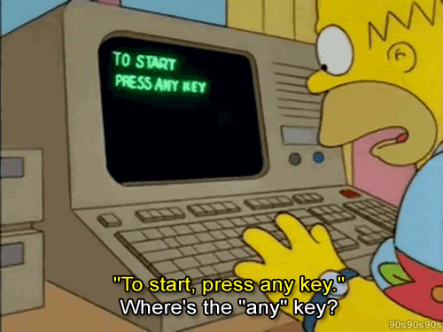
Lab 1-b Programming with Python
Demystifying Computing with Python

Slide 57
Lab session
Download the questions in your local machine:
bddm-1-c-questions.ipynb
Either
Open the notebook in MS VS Code (with Jupyter extension)
or
Upload the notebook to Google Colab:
See next slide for how to upload

Slide 58
